Slide 1
This series of slides illustrates the use of census block data refined to include only areas of likely settlement or ecumene.
Richard Lycan
lycand@pdx.edu
Portland State University
Institute on Aging
8/7/2012

Slide 2
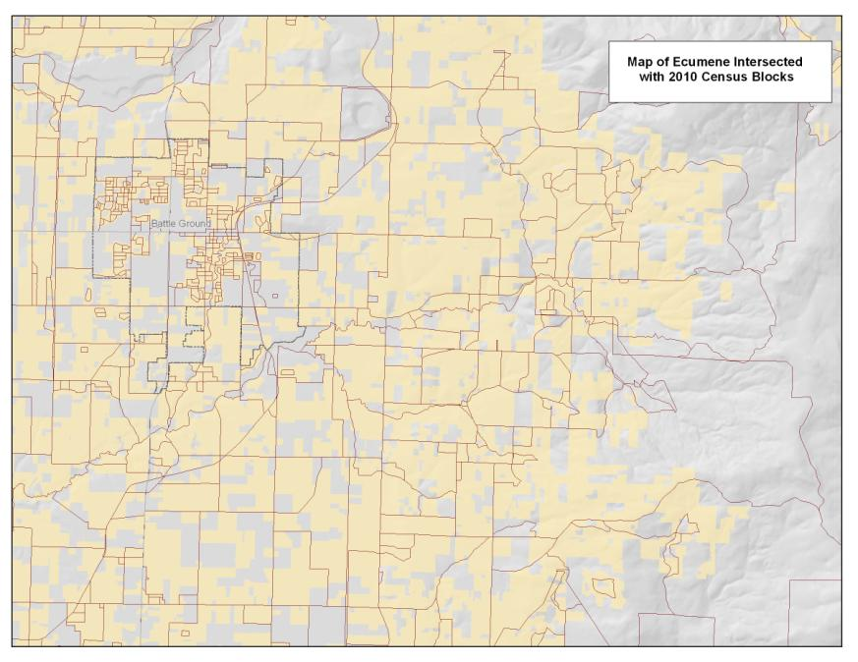
Census Blocks and the Ecumene
A map was constructed from the RLIS and Clark County tax-lot data that attempts to show the ecumene, or where people may reside. Residential and improved farm and forest tax-lots were included along with a representation of group quarters blocks. The tax-lot polygons were generalized using ESRI’s cartographic simplification tools.
Here is an example of an urban part of Portland
Here is an example of rural Clark County.

Slide 3
CREATING THE ECUME MASK AND RASTERIZATION OF CENSUS DATA
To create the ecumene mask, RLIS and Clark Co. tax-lot data were used to select residential tax-lots and rural and improved forest lands tax-lots. Some group quarters (institutions) were manually reinserted into the tax-lot dataset. The result is a dataset showing where people live, and where they don’t, but it is a very complicated map due to street casings and the like. ArcMap cartographic simplification tools were used to meld together lots separated by street casings and features such as the individual representations of apartments and condos within a tax-lot. Then the “ecumene” map was intersected with the census block polygons and the fragments for each census block reassembled into multipart polygons using “dissolve” so that the FIPS code could be associated with the correct block polygon. The block polygons could then be joined to the selected census table using the FIPS code. ArcMap’s random points tool was then used to distribute the polygon values throughout the polygon using the block/ecumene polygons as the constraining class. The points were then rasterized using a 264 foot grid cell size.

Slide 4
Randomized Points into Block/Ecumene Theme
ArcMap’s randomize to polygons tool was used to distribute one dot per person into the intersected block/ecumene theme.
Here a map showing the distribution of the black non-Hispanic Population is shown displayed over that for the total population. The dots are draw at a small size (0.4 points) but tend to fuse in dense areas.

Slide 5
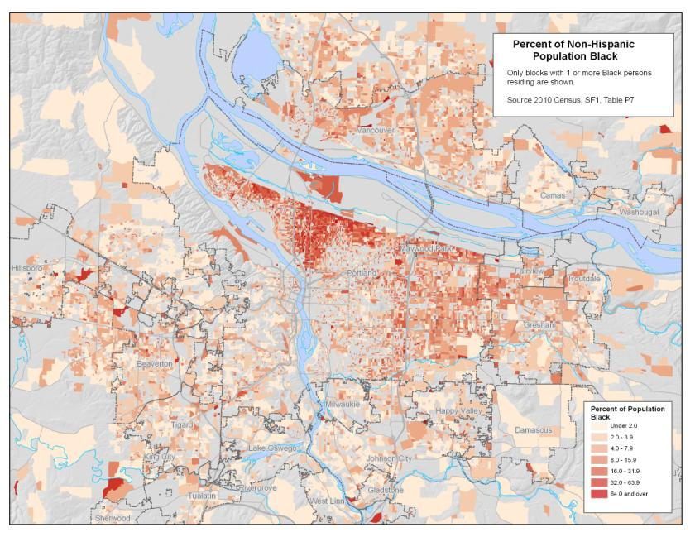
Mapping of Percent Non-Hispanic Black
This is a choropleth map showing percent by race for the block/ecumene intersected layers. The mapping in the rural areas is constrained and is less visually prominent.
This can be compared with the mapping into the original block polygons where the mapping into the rural areas may cause the viewer to overestimate the actual occurrence.

Slide 6
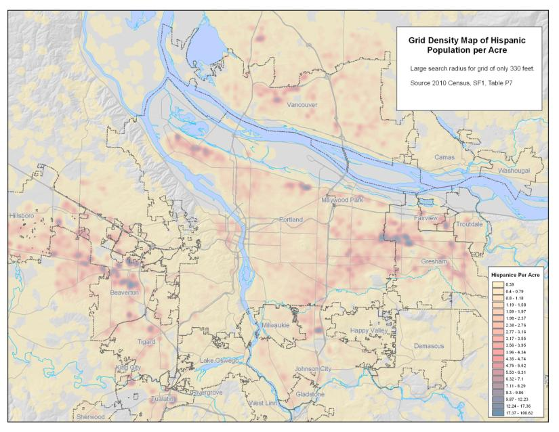
Grid Density Maps
Rather than mapping to the polygon boundaries the randomized points can be used to create a grid density map.
Here is a map based on a 100 foot grid and using grid density mapping with a small 330 foot inclusion radius. It looks similar to the mapping into the block/ecumene polygon boundaries, but is slightly softened.
A second map uses a 1320 foot inclusion radius and produces a more generalized map. The high Hispanic areas tend to produce concentric patterns, but the more generalized appearance may be preferred.

Slide 7
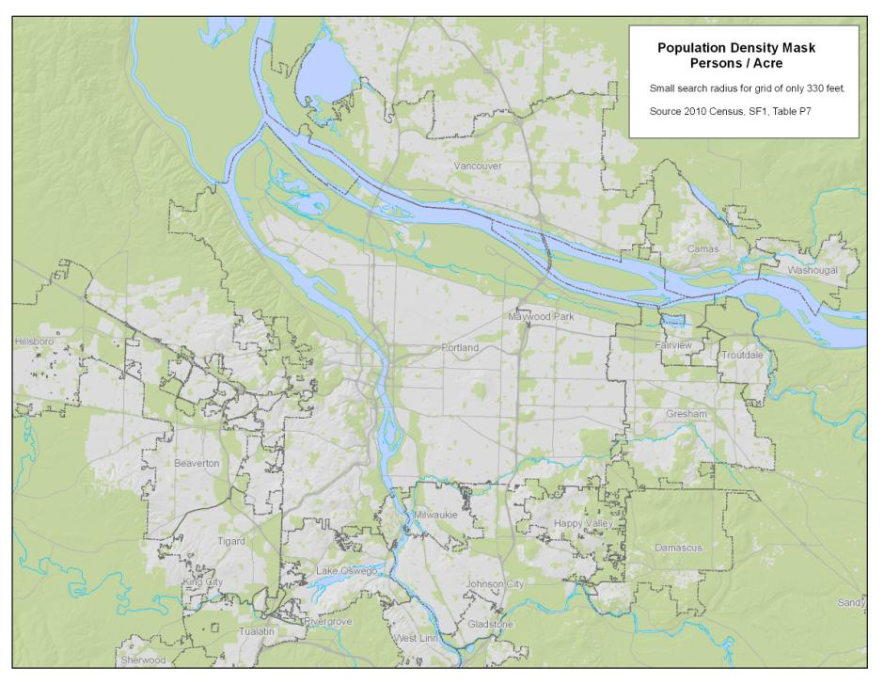
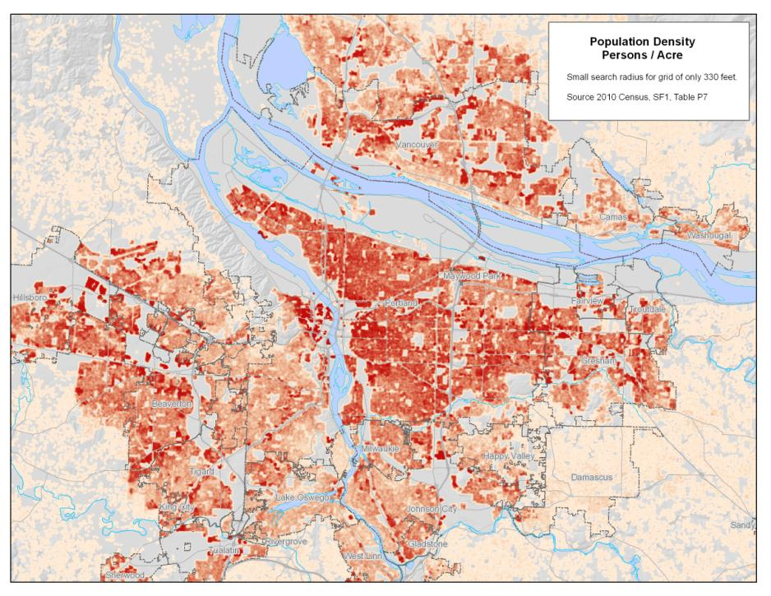
Density Mask
Here is a population density map constructed from census data randomized as points into the block/ecumene theme.
This, or some other density map, can be used to create a density mask to screen out mapping in sparsely populated areas. Areas in green on this map have under 2 persons per acre. This may be converted to a 1/0 grid and multiplied times a density maps to remove data for low population density areas.

